Slide 1
Reaction Mechanisms & ROMs

Slide 2
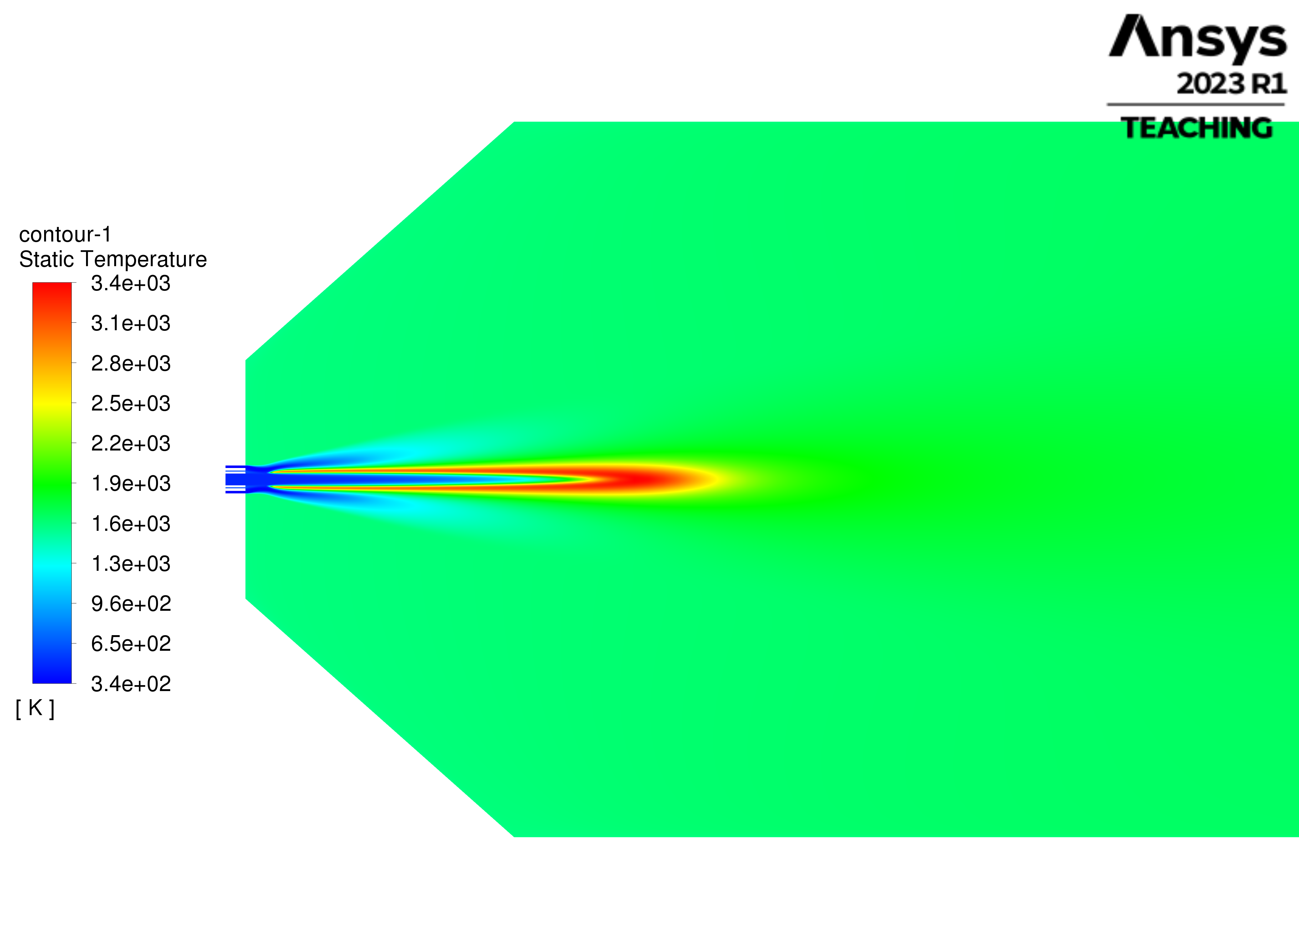
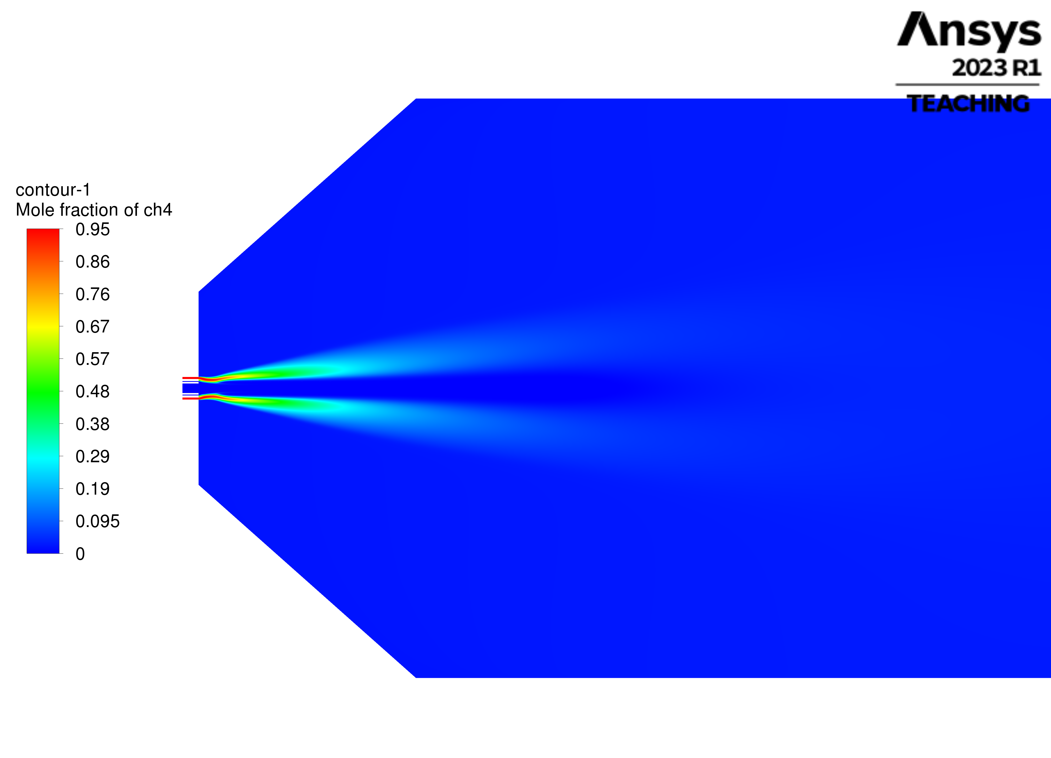
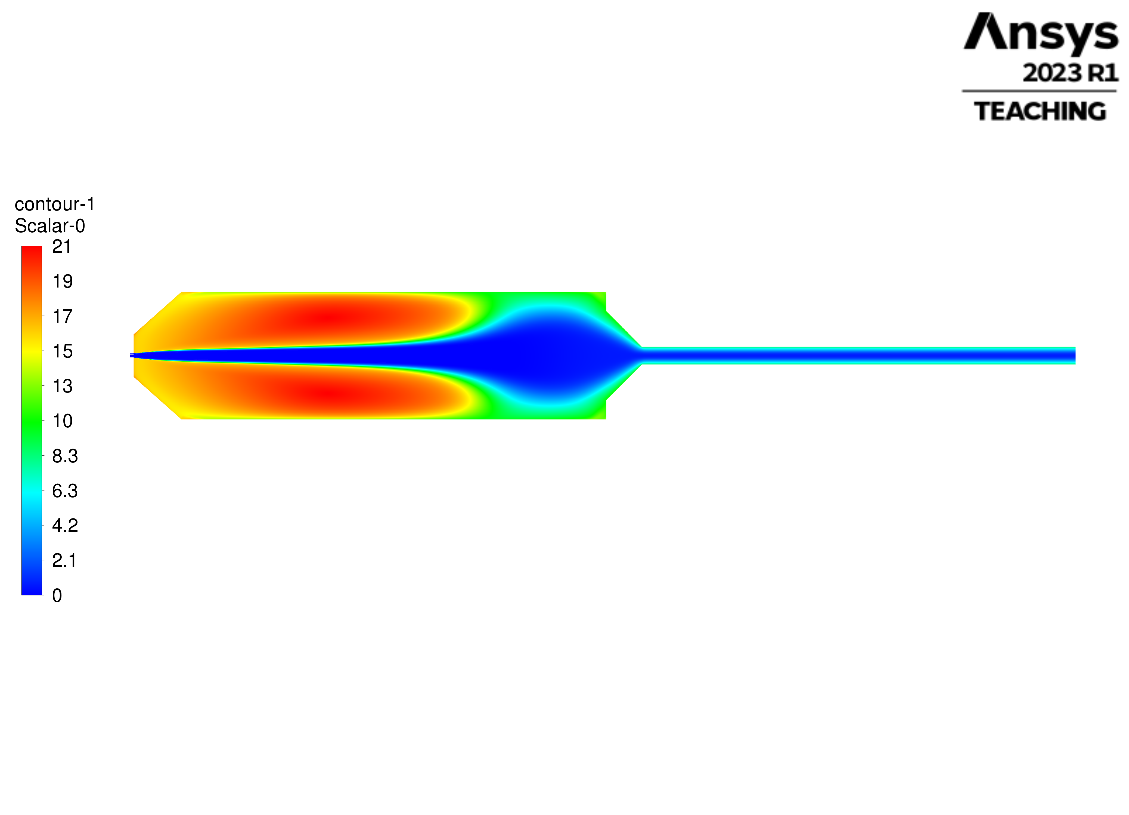



Reactor Network Modeling – Based on CFD Results
Temperature Profile: Flame zone
Methane Profile: Methane bypass zone
Residence Time: Recirculation – Channeling zones
PSR4
PSR1
PSR2
PSR3
PFR1
PFR2
PFR3

Slide 3
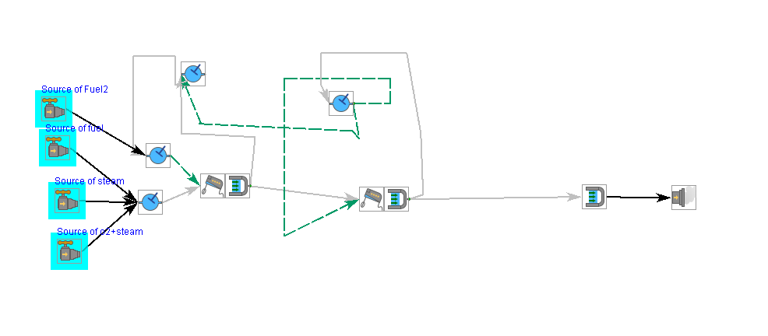
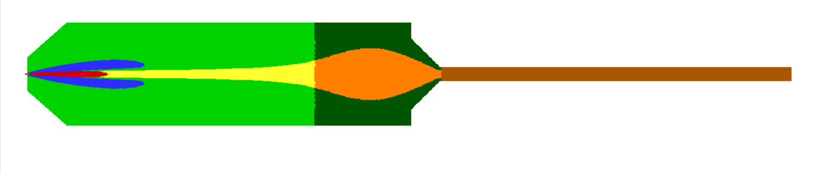
Reactor Network Model
Reactor Segmentation
ROM Model
PSR3
PSR2
PSR4
PSR1
PSR2
PSR4
PSR3
PFR1
PFR2
PFR3
PSR1
PFR1
PFR2
PFR3

Slide 4
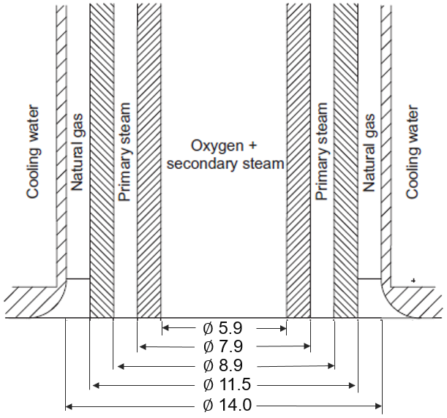
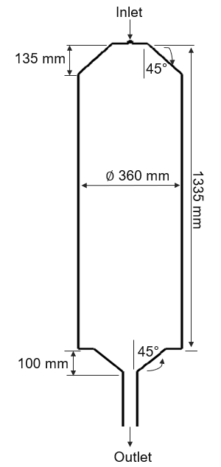
Cases GasPOx215
Variables |  | Case 1 | Case 2
1. Natural Gas
Temperature | °C | 66.6 | 67.5
Mass Flow | kg/h | 182.4 | 153.3
2. Carbon Dioxide
Temperature | °C | - | 67.5
Mass Flow | kg/h | 0 | 196.4
3. Oxygen
Temperature | °C | 231.9 | 231.2
Mass Flow | kg/h | 252.2 | 246.9
4. Steam
Temperature | °C | 353.4 | 353.4
Mass Flow | kg/h | 38.7 | 39.4
Wall Heat Loss | kW | 30 | 30
Reactor Volume | L | 134 | 134
Comment |  | Reference | CO₂ import

Slide 5
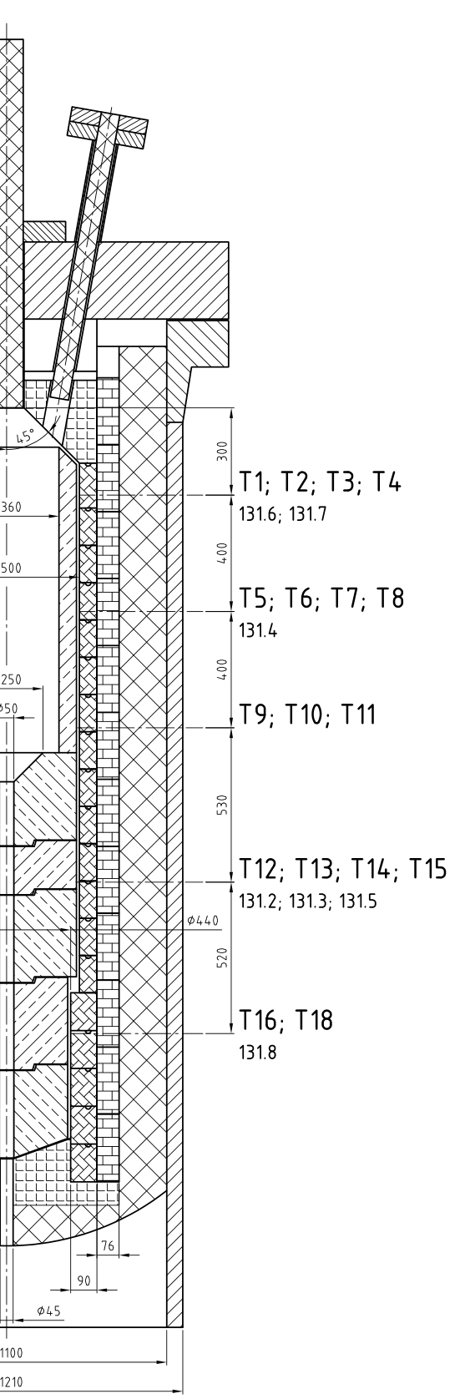
Results GasPOx215
 |  | EP 11 | EP 9
 | Units | EXP | EXP
Syngas (wet) | kg/s | 0.133 | 0.178
Temperature Outlet | °C | (1300) * | (1342) *
Temperature T102.11 | °C | 1407.4 | 1411.4
Temperature T102.15 | °C | 1351.9 | 1371.6
H₂ | Vol.- dry | 0.599 | 0.416
CO | Vol.- dry | 0.341 | 0.424
CH₄ | Vol.- dry | 0.007 | 0.0012
CO₂ | Vol.- dry | 0.048 | 0.151
H₂/CO | - | 1.759 | 0.981
*Aspen calculated temperature

